Slide 1



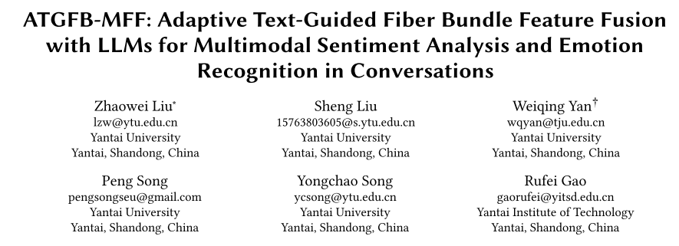





Chongqing University of Technology
ATAI
Advanced Technique of Artificial Intelligence
Chongqing University of Technology
—— WWW 2026
Reported by ZhiWei Xu

Slide 2
Motivation
1)Firstly, LLMs are naturally text-centric and cannot directly process non-text modalities like audio or vision.
2)Secondly,multimodal features often suffer from alignment issues, degrading representation learning.traditional fusion methods process data within a single flat latent space, reducing interpretability and limiting the generalization potential of LLMs.

Slide 3
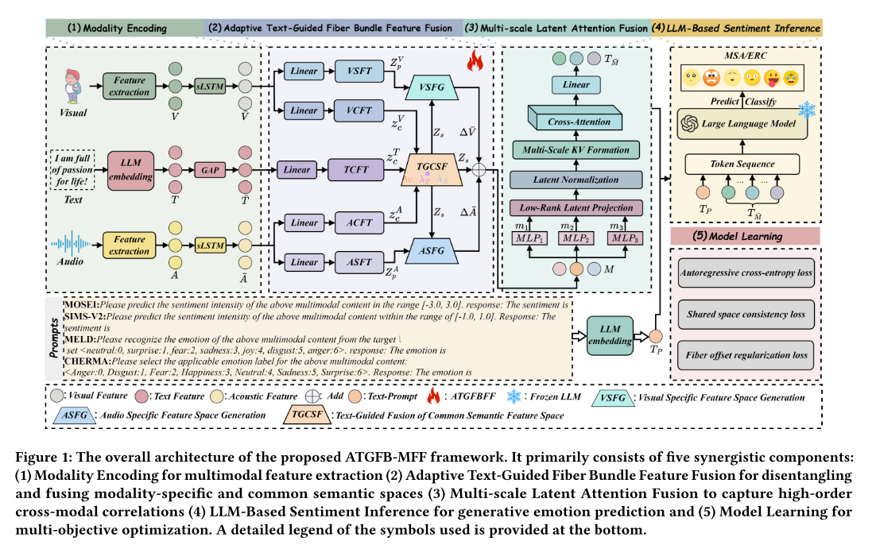
Method

Slide 4






Method

Slide 5






Method

Slide 6



Method

Slide 7
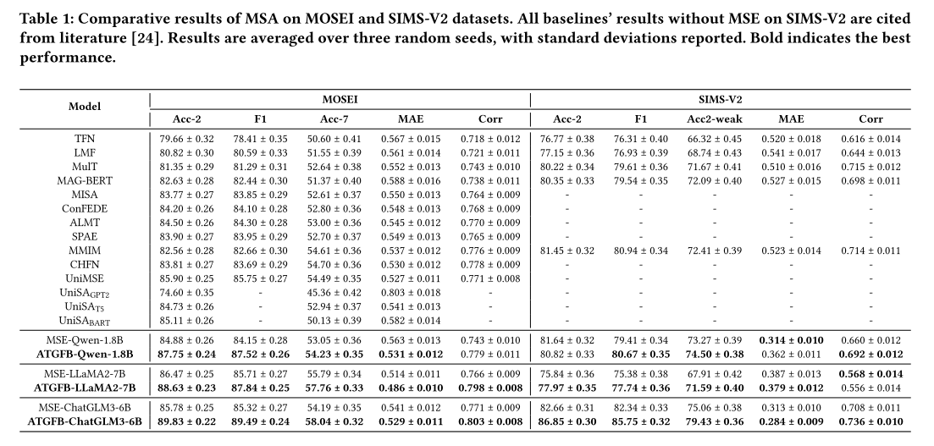
Experiments

Slide 8
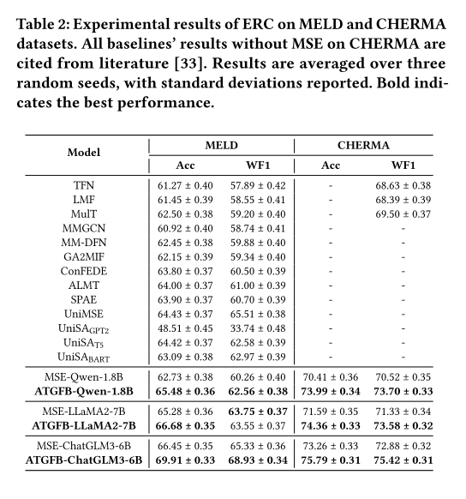
Experiments

Slide 9
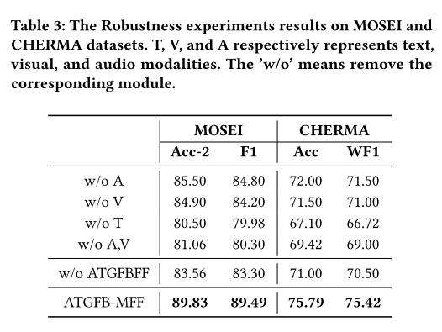
Experiments

Slide 10
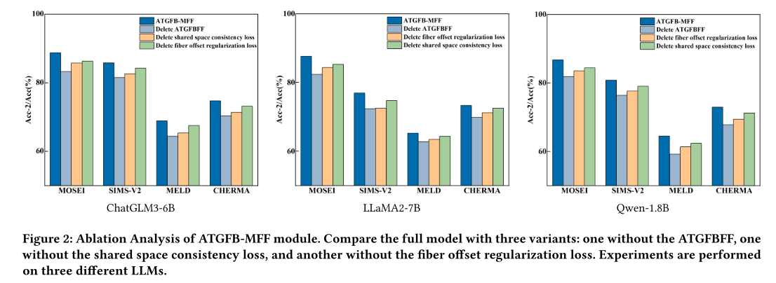
Experiments

Slide 11
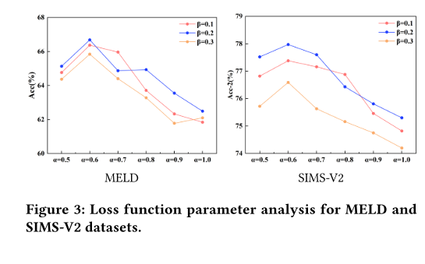
Experiments

Slide 12
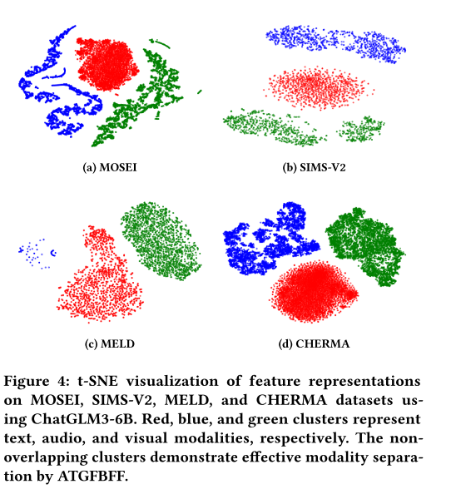
Experiments

Slide 13
Thanks!

